Slide 1


Slide 2

HOTEL MANAGEMENT
SYSTEM

Slide 3
Group no.-5 GROUP MEMBERS:-
ASHISH SHARMA (0905CS191056)
FAIZAL NAZIR AHMAD (0905CS191073)
GAUTAM SAHU (0905CS191080)
JAYESH KATARE (0905CS191090)
KHUSHI CHANDIL (0905CS191097)

Slide 4
CONTENT
S.NO | TITLE | SLIDE
1. | INTRODUCTION
2. | OBJECTIVES
3. | PURPOSE
4. | EXISTING FEATURES
5. | SYSTEM FACILITIES
6. | SOFTWARE & HARDWARE REQUIREMENTS
7. | SYSTEM ARCHITECTURE
8. | PROJECT SCREENSHOTS
9. | REFERENCES

Slide 5
Introduction
We have tried our best to make the complicated process of Design and Development of Web Based Hotel Management System as simple as possible using Structured & Modular technique & Menu oriented interface. This project is used by two types of users :
i. Online User and
ii. Administrator (management of the Hotel).

Slide 6
OBJECTIVES
The aims of this project are as follows:
To keep the record of our customers
To maintain security of our system
To improve our services.
To keep the billing records of each day
To reduce human efforts
The proposed system is a hotel management system which will allow for staff to view rooms that are available and highlight rooms that have already been booked.

Slide 7
Purpose
The main purpose of my exercise is perform each Employee’s activity in computerized way rather than manually which is time-consuming.
The entire activity is to automate the process of day to day activities of Hotel like
Room activities very safely,
Assign a room according to customer’s checkout of a computer and
Releasing the room and finally compute the bill in short time .

Slide 8
Existing features
“HOTEL Management System” has been designed to computerize the following functions that are performed by the system :
Room Detail Functions
Opening a New Room
Modification to Room assigned
Check-in and check-out Functions
Sign-up of New customer
Room assigning related to customer’s need
Statement of customer Details
Room Details
Individual customer Report.

Slide 9
System facilities
Booking a room online add up long before guest’s arrival.
The most important advantage of online room booking is convenience.

Slide 10
Software Requirements
Programming language used: PYTHON 3.9
GUI Creation: Tkinter
IDE used: PyCharm
Database: SQLite

Slide 11
Hardware Requirements
Processor:- Intel i3 or i5 1.8 GHz.
Mother Board:- According to the processor requirement.
Ram:- 4GB
Free disk space:- 100MB

Slide 12
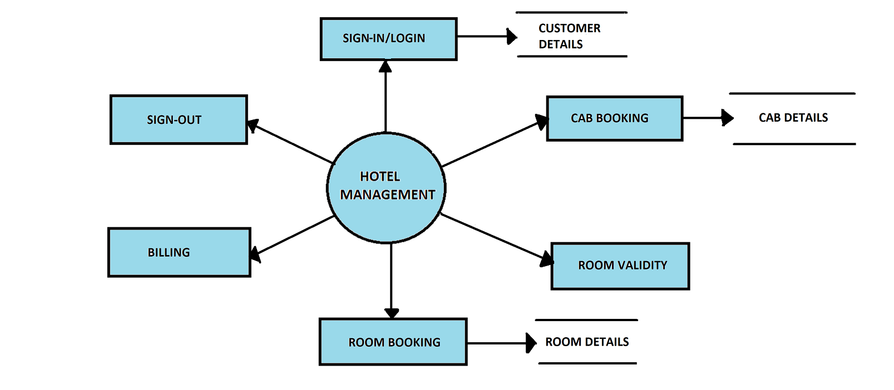
System architecture

Slide 13
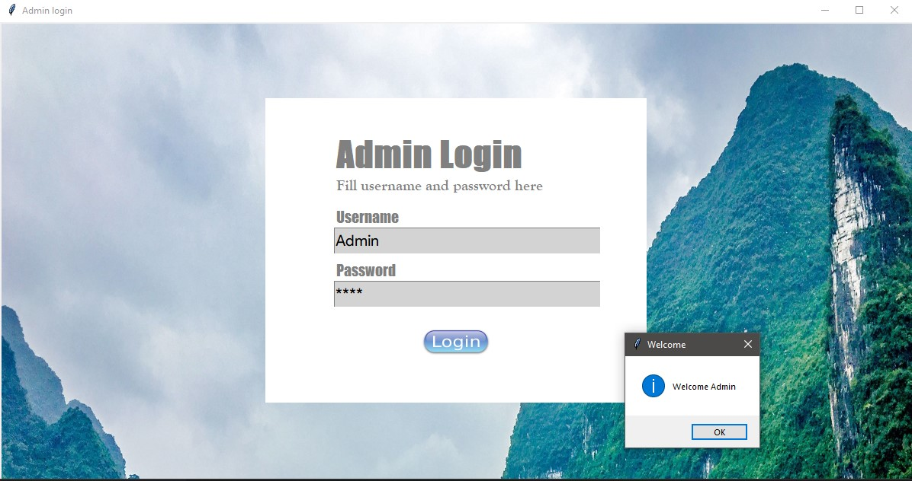
PROJECT SCREENSHOTS

Slide 14
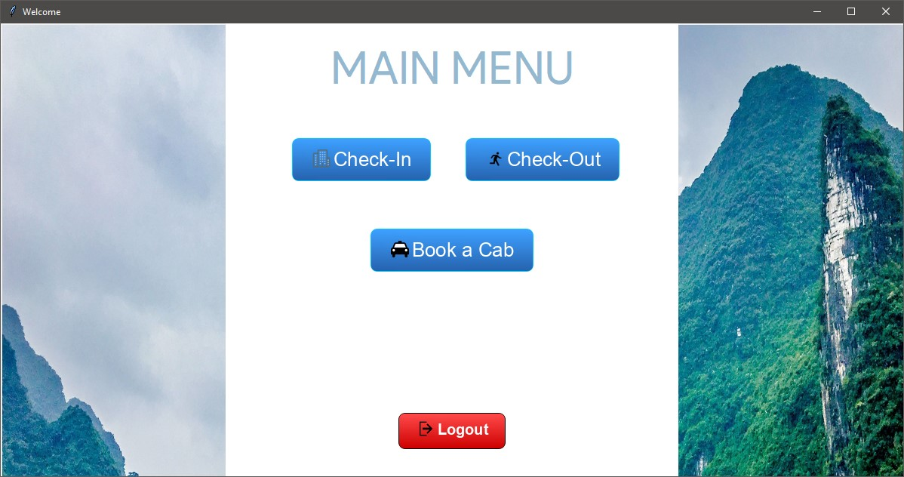
CONT…

Slide 15
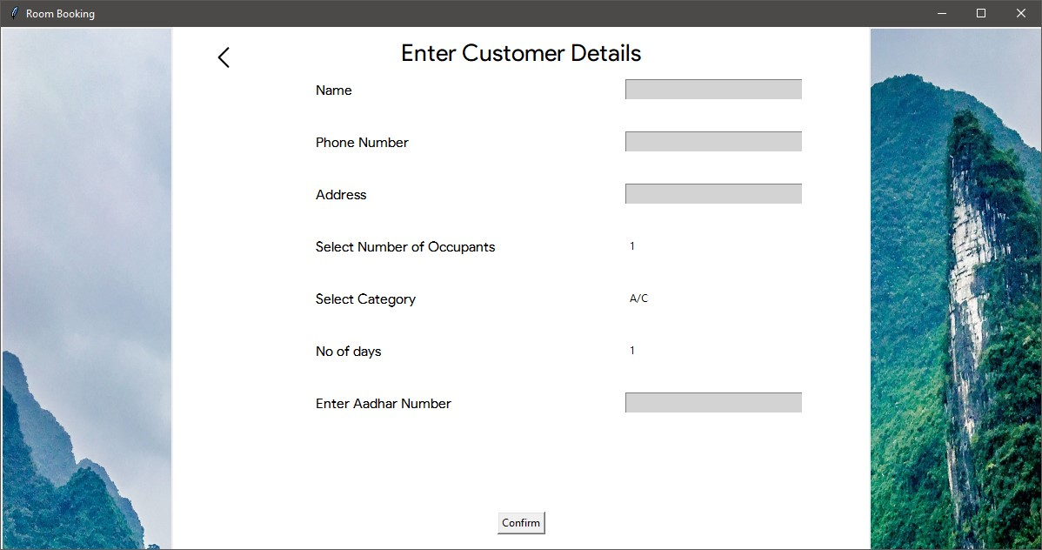
Contd.

Slide 16
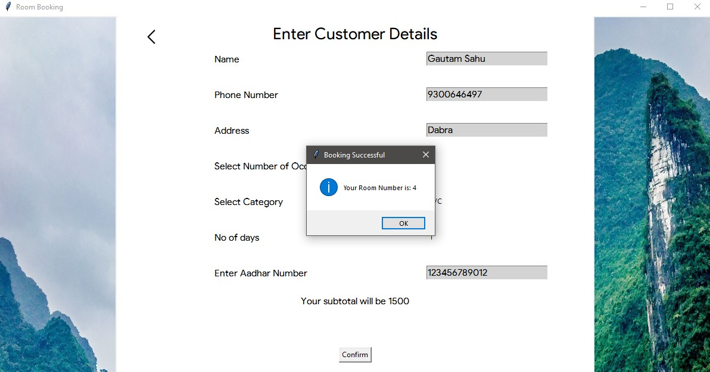
CONT…

Slide 17
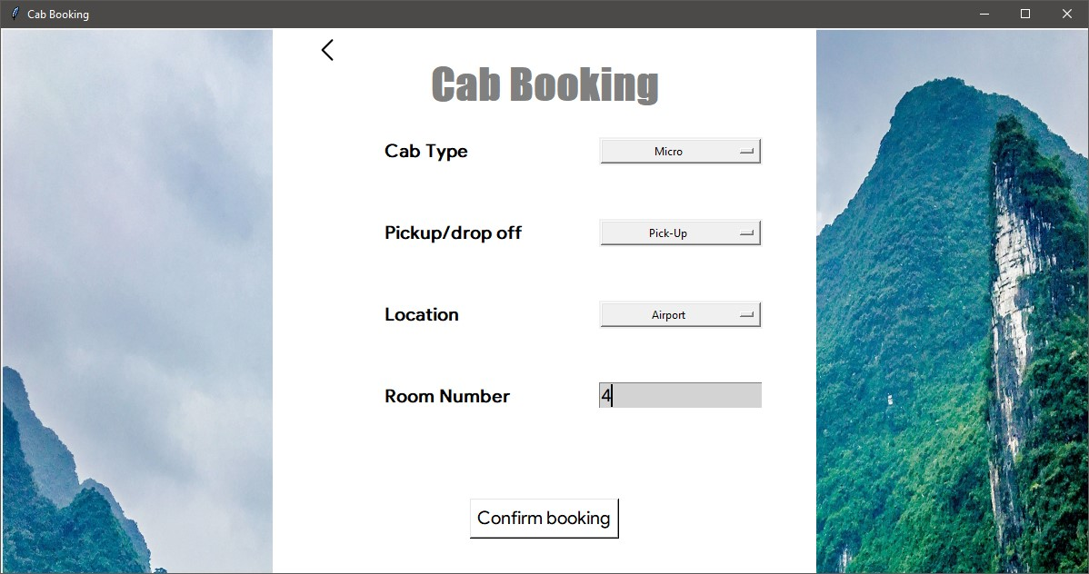
CONT…

Slide 18
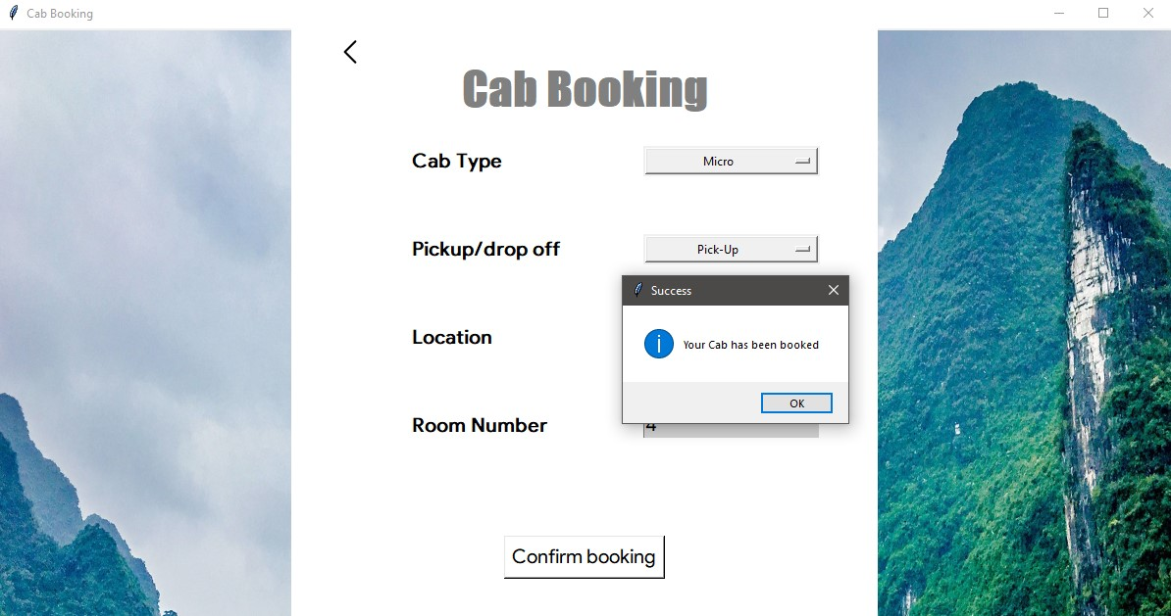
CONT…

Slide 19
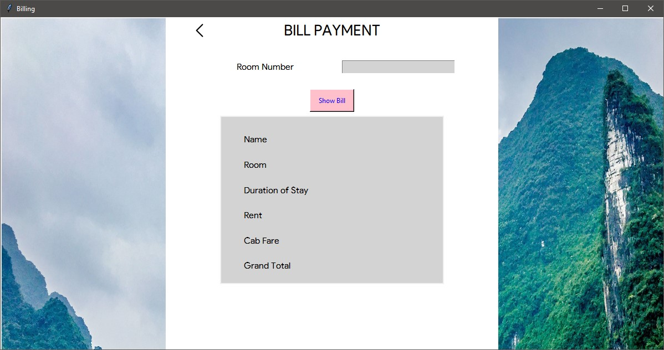
CONT…

Slide 20
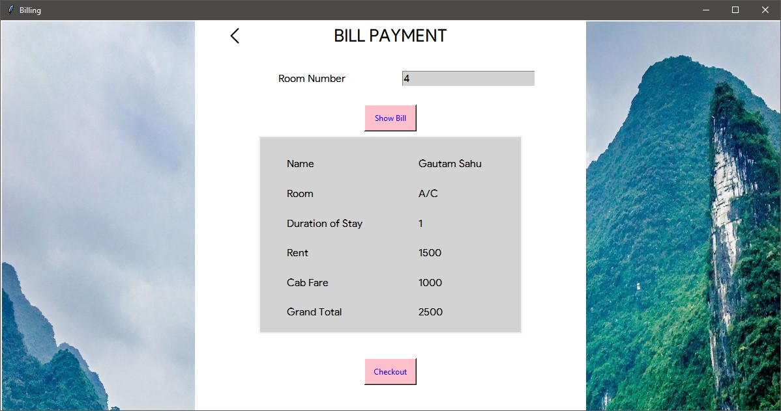
CONT…

Slide 21
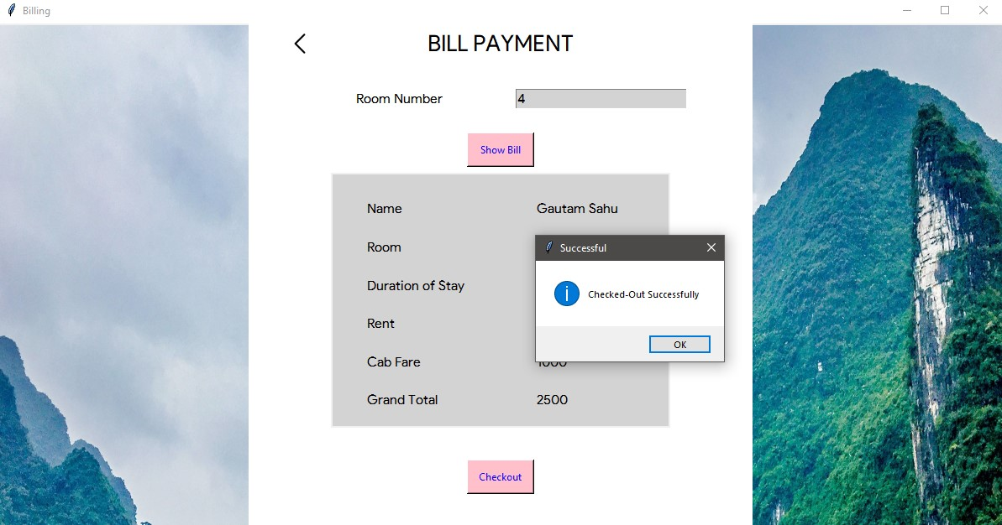
CONT…

Slide 22
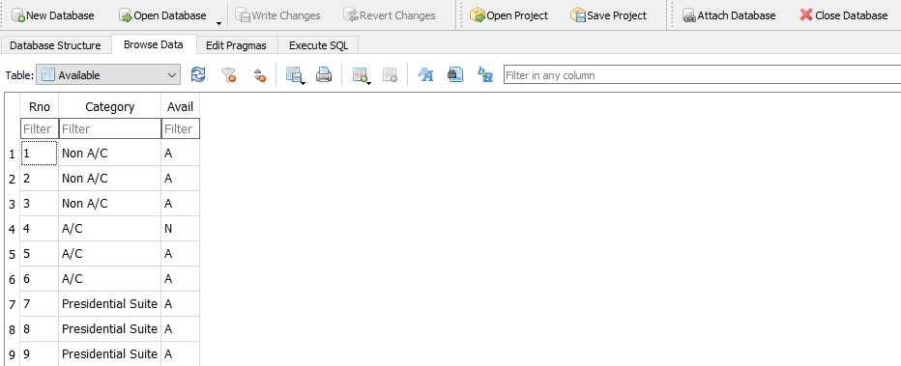
Contd.

Slide 23
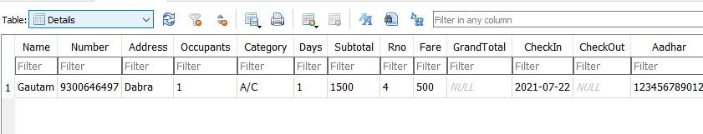
Contd.

Slide 24
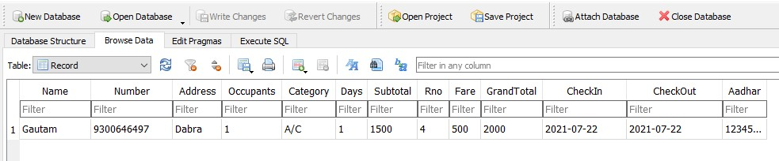
Contd.

Slide 25
REFERENCES
www.geeksforgeeks.org
www.stackoverflow.com
Training Notes
Let us python by Yashwant Kanetkar

Slide 26
THANK YOU

